Slide 1
Platform Device Driver
Prepared by: Mostafa Tera

Slide 2
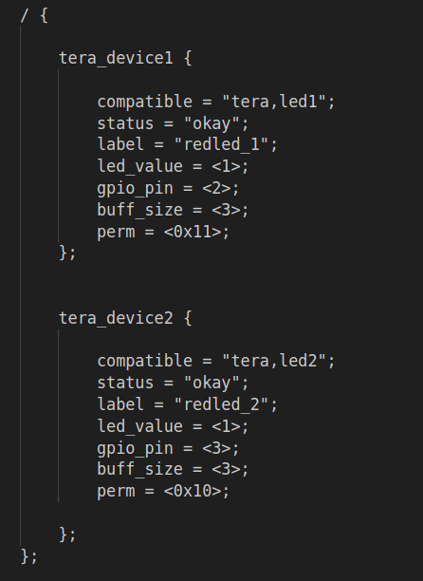
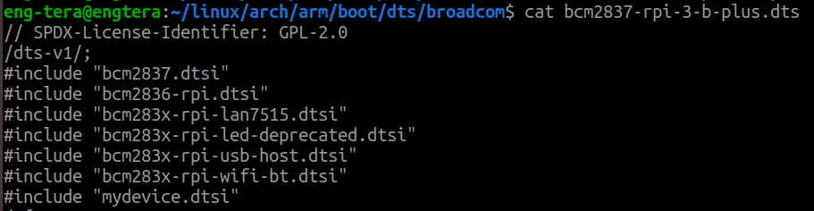
Detailed Flow of Device Creation and Driver Binding
1) Writing the Device Tree Source (DTS)
- Create a Device Tree Source (DTSI) file defining your devices
- Go to your cloned linux repo
- Find this path linux/arch/arm/boot/dts/broadcom
- Include your dtsi into bcm2837-rpi-3-b-plus.dts
- Run ‘ make dtbs ’ and move the output dtb to your boot partition

Slide 3
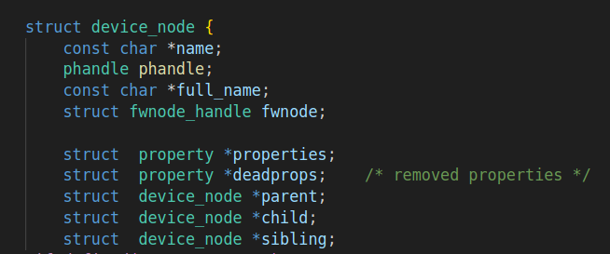
Detailed Flow of Device Creation and Driver Binding
2) Parsing the Device Tree
Responsibility: Device Tree Subsystem
Action: The kernel parses the DTB to create struct device_node instances.
- Each node in the DTB becomes a struct device_node
1
1
2

Slide 4
Detailed Flow of Device Creation and Driver Binding
3) Creating Platform Devices
Responsibility: Device Tree Subsystem
Action:
- The kernel creates struct platform_device instances based on the struct device_node instances.
- This involves using functions like of_platform_device_create() to create struct platform_device instances
from the struct device_node instances.
- During this process, the kernel initializes the struct device within the struct platform_device instances.

Slide 5
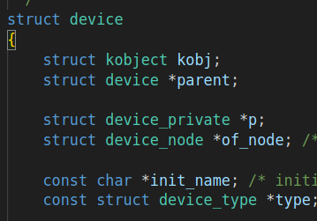
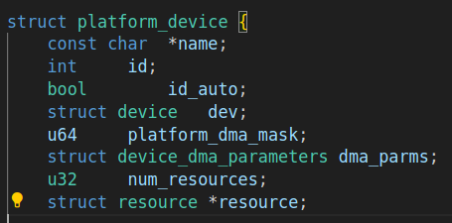
Detailed Flow of Device Creation and Driver Binding
3) Creating Platform Devices
Responsibility: Device Tree Subsystem
2

Slide 6

Detailed Flow of Device Creation and Driver Binding
4) Registering Platform Devices
Responsibility: Device Tree Subsystem
Action: The platform device is registered with the platform bus using platform_device_register();

Slide 7
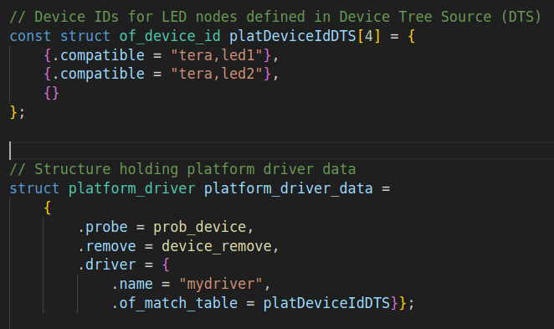
Detailed Flow of Device Creation and Driver Binding
5) Binding with Drivers
Responsibility: Platform subsystem
Action: The kernel matches the registered platform device with appropriate drivers.
The of_match_table of the driver is used to match the compatible property in struct device_node.
Our Driver

Slide 8
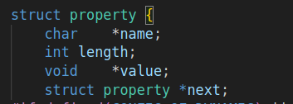
Detailed Flow of Device Creation and Driver Binding
6) Calling the probe Function
Responsibility: Platform subsystem
Action: The probe function of the matched driver is called.

Slide 9
Extracting the device properties in prob function
As we saw eariler the device properties are passed to prob function in struct platform_device
How to extract these properties?
1) You need to make sure that the property you are looking for exists
- You can do this by calling this function ->
2) If it exists, then read the value of the property using one of those functions based on the value type
- If the property is int →
- if its a string →
NOTE: THESE FUNCTIONS TAKES struct device WHICH IS INSIDE struct platform_device

Slide 10
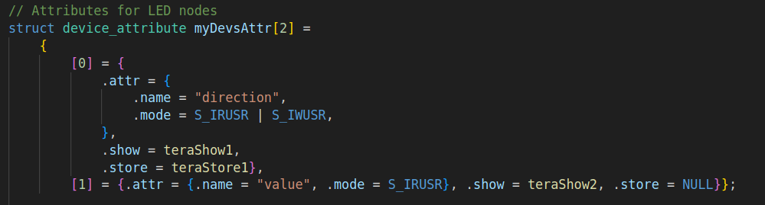
What is Attributes?
Attributes in device drivers are properties or settings associated with a device,
exposed to user space via the sysfs filesystem.
How to create attributes for your devices?
1) Define your attributes in struct device_attribute
Example:

Slide 11
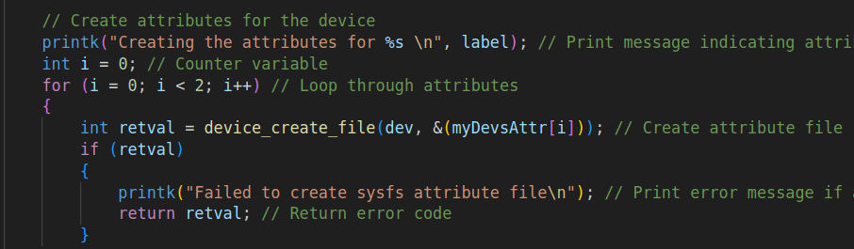
How to create attributes for your devices?
2) Create each attribute by calling device_create_file();
Example for 2 attributes:

Slide 12
Device Drivers in YOCTO

Slide 13
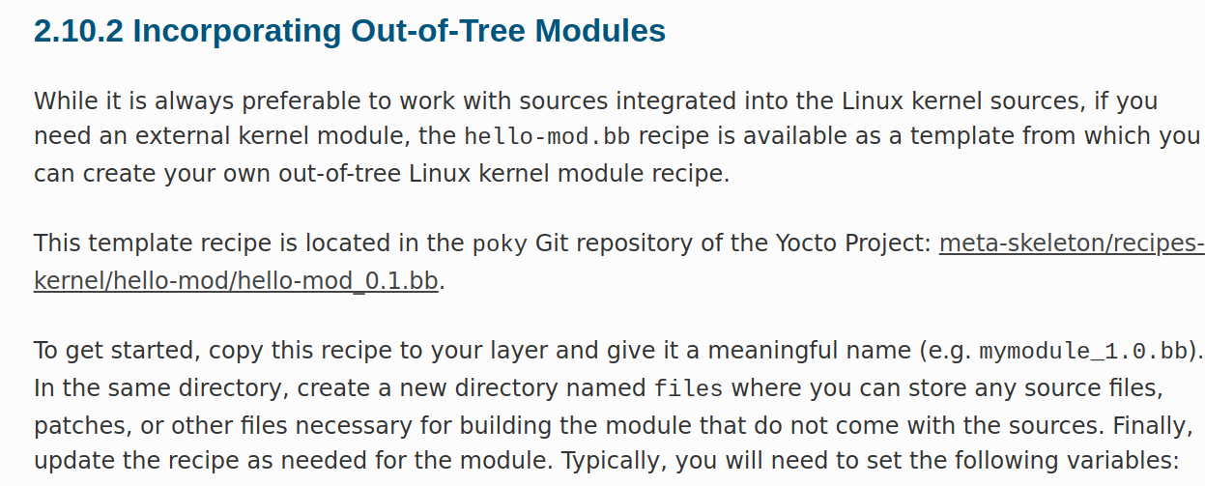

Slide 14
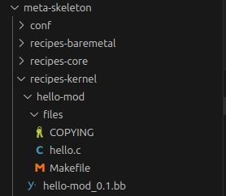
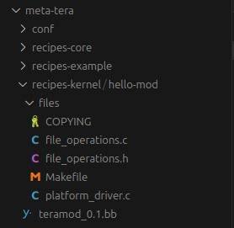
So based on the Documentation we need to copy the template into our layer:
Copy the template
to your layer

Slide 15
Now lets discuss the recipe and Makefile and understand them better

Slide 16
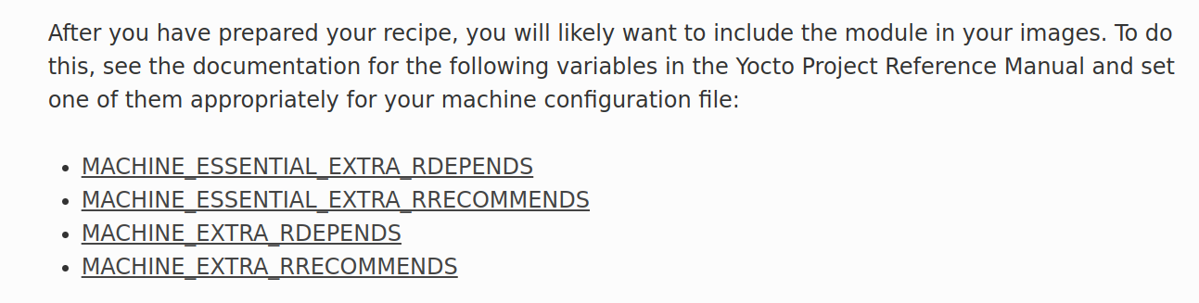

Based on the Documentation
We need to add this variable to local.conf or our machine.conf is you have one

